Slide 1
Launching and Building Your YMCA Endowment Part I
2012 NAYDO Conference
Pittsburgh, April 26, 2012

Slide 2
Agenda for Part I:
• Endowment, planned giving, and elements of successful endowment building
• Step 1: Board commitment, policies and governance
• Step 2: Case for support and endowment “products”
• Step 3: Identify, cultivate, and invite prospective donors and other audiences
• Step 4: Monitor and measure
• Questions and wrap-up
Agenda for Part II: Endowment Building Clinic
2
NAYDO – April 2012

Slide 3

En•dow•ment
  A pool of money invested for total return, with a percentage of the endowment’s balance paid out annually for use by the organization as the donor stipulated or as the board determines.
3
NAYDO – April 2012

Slide 4
^{Endowment, UPMIFA definition}
  “An institutional fund, or any part thereof, not wholly expendable on a current basis under the terms of the donor’s gift agreement.”
4
NAYDO – April 2012

Slide 5
Endowment …
Is not…
A savings account
A rainy day fund
Emergency reserves
A substitute for annual fundraising
Is…
Intentional
Sustainable
Well managed
Disciplined
Predictable
Future oriented
5
NAYDO – April 2012

Slide 6
^{Three Types of Endowments}
  • True or permanent
    The donor has stated the gift is to be held permanently as an endowment
  • Quasi (funds functioning as endowment)
    The board of directors has designated organizational funds to the endowment
  • Term
    Funds set aside to act as endowment for a set period of years or until a future event
6
NAYDO – April 2012

Slide 7
Endowment ≠ Planned Giving
Endowment:
How the gift is used
  An endowment gift is invested long-term total return
  A small portion of the fund’s balance is distributed annually for use by the organization
  Endowment is often built through planned and deferred gifts
Planned Giving:
How to give
  Gifts that result from the donors’ personal, financial, and estate planning decisions
  Sometimes given now, often deferred
  Contributions made as a result of a thoughtful process for endowment or current use.
7
NAYDO – April 2012

Slide 8
Endowment Myths and Fears
“If we have an endowment, donors will think we don’t need their money.”
“Donors who give to endowment won’t give as much/won’t give at all to our annual fund.”
“Only an expert (staff member) can cultivate and solicit an endowment gift.”
“Endowment fundraising takes too long.”
“We’ll have to expend current resources, and won’t see results for years.”
8
NAYDO – April 2012

Slide 9
Elements of Successful Endowment Building
  The board of directors and staff are committed to building the endowment.
  Leaders are stable, knowledgeable, and available.
  The organization is strong, has a clear mission.
  The organization has a compelling case for future support.
  A solid fundraising program is in place.
  Substantial gifts inspire generous contributions from others
  A constituency-wide communications plan is in place.
  Written endowment policies are established.
9
NAYDO – April 2012

Slide 10
Step 1
Board Commitment
Policies
Governance
10
NAYDO – April 2012

Slide 11
Building Board Commitment
Begin by educating/informing
  Distribute literature
  Invite speakers to board meetings
Identify board “champions”
Draft & adopt a resolution to build endowment
Create endowment planning committee(s)
  Conduct an assessment, if appropriate
11
NAYDO – April 2012

Slide 12
What Policies Need to be in Place?
Gift Acceptance
  See National Committee on Planned Giving Guidelines at www.ncpg.org
Investment Policy
  Consult with YMCA-USA or local community foundation
Spending Policy
  Recommend “total return” of 4%-5%
  (Share policies with investment managers, interested prospective donors, and legal and financial advisors.)
12
NAYDO – April 2012

Slide 13
What Documents and Procedures are Needed?
  • Sample gift agreements
  • Content index for donor files
  • Gift administration procedures
  Recognition and stewardship guidelines
13
NAYDO – April 2012

Slide 14
Policy Recommendations
Set a diverse and balanced investment policy (neither too conservative nor too aggressive).
Establish realistic long-term investment expectations (neither too high nor too low).
Set reasonable draw percentages; use the draw for important and visible purposes; don’t defer draw altogether.
Don’t allow donors to negotiate investment strategies.
14
NAYDO – April 2012

Slide 15
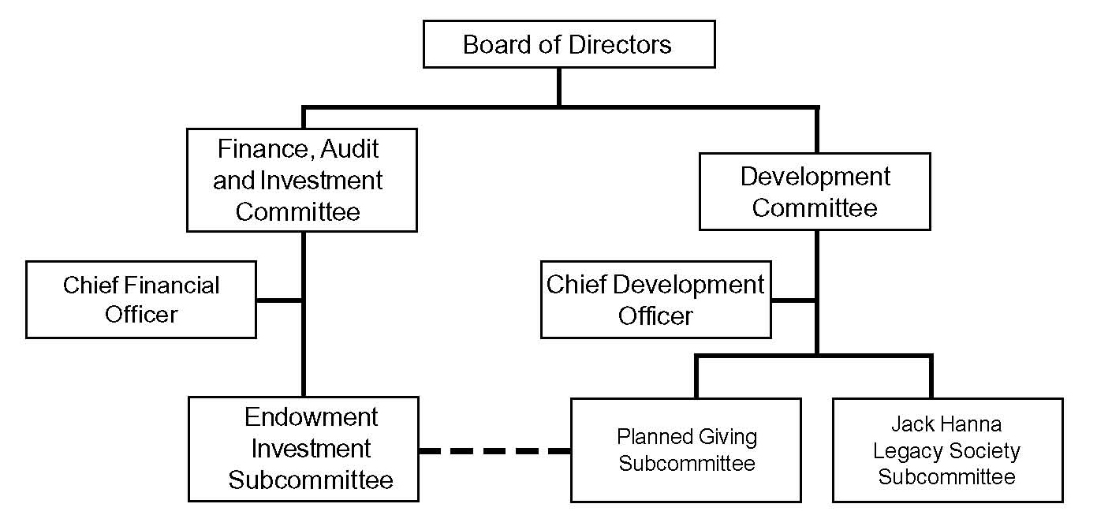
Typical Endowment Governance
15
NAYDO – April 2012

Slide 16
Step 2
Case for Support
Endowment “Products”
16
NAYDO – April 2012

Slide 17
Defining a Case for Endowment
Why should donors make a long-term investment in your YMCA?
  How will their gift change lives/save lives in perpetuity?
What options does a donor have?
  Legacy Society membership
  Unrestricted gifts of any amount
  “Field of Interest” funds (e.g., scholarships, programs)
  Designated funds ($50,000 or more)
How will your organization be a good steward of the endowment?
17
NAYDO – April 2012

Slide 18
Ways to Build Endowment
Sustained planned giving
Legacy Society
A focused campaign
A component of a capital campaign
Set aside proceeds from an event or activity
Luck/windfall gifts
NAYDO – April 2012

Slide 19
^{Types of Gifts}
  ^{Current gifts}
  ^{• Cash}
  ^{• Stocks and bonds}
  ^{• Real estate}
  ^{• Personal property}
  ^{• Bargain sale}
  ^{• Charitable lead trust}
19
NAYDO – April 2012

Slide 20
^{Types of Gifts}
  ^{Deferred gifts}
  ^{• Bequest}
  (specific, percentage, residuary, contingent)
  ^{• Life insurance}
  ^{• Retirement assets}
20
NAYDO – April 2012

Slide 21
^{Types of Gifts}
  ^{Split interest gifts}
  ^{• Charitable gift annuities}
  ^{• Charitable remainder trusts}
  • Retained interest in real estate
21
NAYDO – April 2012

Slide 22
Typical Planned Giving Society
Name: meaningful to constituents
Membership requirements:
  Current gift of $5,000+ to endowment --or--
  Notification of a planned gift
Recognition/Benefits
  Annual event, memento, recognition at facility and in print materials, special invitations
  $10,000+ for a named fund (unrestricted or field-of-interest)
  $50,000 for a named fund with a donor-designated purpose
22
NAYDO – April 2012

Slide 23
Step 3
Identify, Cultivate, and Invite Prospective Donors and Other Audiences
23
NAYDO – April 2012

Slide 24
^{Endowment giving: process}
4.
Steward
1.
Identify
3.
Solicit
2.
Cultivate
24
NAYDO – April 2012

Slide 25
Endowment giving: identification
  ^{Who are the potential donors?}
    ^{• Individuals, primarily}
    • Corporations & foundations, usually not but may support the endowment building program
Current & former board members
Current donors
Long-term donors and volunteers
New donors
a. linked to leaders
b. served by organization
c. give to similar causes
25
NAYDO – April 2012

Slide 26
Understanding Endowment Donors
Why they give
  Passion for the mission
  Shared values/beliefs
  Desire to make a difference
  Give something back
  Leave a legacy
  Confidence in the organization/solicitor
  Dedication to a specific program
  Recognition in perpetuity
  Tax, financial advantages
Why they don’t give
  They were never asked (or asked in the wrong way)
  Lack of follow up
  Insufficient passion
  Lack of confidence in the organization or its leaders
  Financial insecurity
26
NAYDO – April 2012

Slide 27
Endowment Action Program
Identify Prospects
  “Check box” on all reply devices
  Data mining
  Professional advisors committee
  Legacy events
Cultivate and Educate
  Legacy events
  Publications
  Web site
Invitation/Solicitation
  Follow up
  Benefits & recognition
27
NAYDO – April 2012

Slide 28
^{Endowment giving: solicitation}
  ^{• The 4 W’s:}
    W^{ho asks}
    W^{hom for}
    W^{hat amount}
    W^{hen}
Insiders make initial gifts, followed by the largest gifts
Because people rarely give unless they are asked.
28
NAYDO – April 2012

Slide 29
^{Endowment giving: stewardship}
Discuss values and beliefs
Seek an investment in the future of the organization
Cultivate a lifelong donor and advocate for the YMCA
29
NAYDO – April 2012

Slide 30
Endowment Marketing Strategies
 | Make Case | Build Case | Get Leads | Qualify Leads | Close Gifts | Steward Gifts | Repeat Gifts
Direct Mail | ✓ | ✓ | ✓
Special Events | ✓ |  | ✓ |  |  | ✓
Advertising | ✓ | ✓
Web Site | ✓ | ✓ | ✓ |  |  | ✓
Group Gatherings | ✓ | ✓ | ✓
Seminars | ✓ | ✓ | ✓
Newsletter | ✓ | ✓ | ✓ |  |  | ✓ | ✓
Personal Visits | ✓ | ✓ | ✓ | ✓ | ✓ | ✓ | ✓
Recognition |  |  |  |  | ✓ | ✓ | ✓
30
NAYDO – April 2012

Slide 31
Step 4
Monitor
Measure
31
NAYDO – April 2012

Slide 32
How to Measure Progress/Success
 | Goal | Actual
Prospects identified
Prospects qualified
Professional advisors involved
Mailings, ads, web hits’
Attendance at events/seminars
Legacy Society memberships
Value of gifts & expectancies
32
NAYDO – April 2012

Slide 33
Questions?
Questions?
33
NAYDO – April 2012

Slide 34
Agenda for Part II: Endowment Building Clinic
Calculating Endowment
Assessing Readiness for Endowment Building
Listing Potential Endowment Opportunities
Drafting the Case for Endowment
Developing a Budget, Timeline, & Endowment Action Program
Measuring Progress
34
NAYDO – April 2012

Slide 35
Calculating Endowment Using a “Total Return” Spending Policy
 | Year 1 | Year 2 | Year 3
Endowment value, start of year | $500,000 | $601,650 | $704,550
+ growth (@ 6%) | $30,000 | $36,099 | $42,273
+ new contributions | $100,000 | $100,000 | $100,000
= endowment’s total value | $630,000 | $737,749 | $846,823
- disbursement (4.5% of 3-year average) | $28,350 | $33,199 | $38,107
= total value, end of year | $601,650 | $704,550 | $808,716
35
NAYDO – April 2012

Slide 36
en•dow•ment exercise
Are you Ready to Build Endowment?
Worksheet 1
36
NAYDO – April 2012

Slide 37
Worksheet 1:
Are You Ready to Build Endowment?
Factor | Maximum | Your Score
The Board and Staff are committed to building endowment | 20
There is an adequate pool of committed and knowledgeable leaders | 20
We have a strong, clear mission and are worthy of philanthropic support | 15
We have a compelling case for future support | 15
Our current fundraising program is solid | 10
We have the potential to attract substantial gifts | 10
We communicate effectively with our constituents | 5
We have written policies for endowment | 5
37
Adapted from Jacquelyn B. Ostrom. “The Ultimate in Nonprofit Sustainability: Raising Endowment Dollars.” 2004 AFP International Conference, as cited in Diana S. Newman. “Endowment Building.”

Slide 38
en•dow•ment exercise
Identify Endowment Opportunities
Worksheets 2 and 3
38
NAYDO – April 2012

Slide 39
Worksheet 2:
Potential Endowment Opportunities
Broad “Fields of Interest” Opportunities | Annual Funding Desired | Endowment Required
39
NAYDO – April 2012

Slide 40
Worksheet 3:
Potential Endowment Opportunities
Designated Opportunities | Annual Funding Desired | Endowment Gift Required
40
NAYDO – April 2012

Slide 41
Example: Endowed Funds
41
NAYDO – April 2012

Slide 42
Building a Case for Endowment
Why should donors make a long-term investment in your YMCA?
  How will their gift change lives/save lives in perpetuity?
What options does a donor have?
  Legacy Society membership
  Unrestricted gifts of any amount
  “Field of Interest” funds (e.g., scholarships, programs)
  Designated funds ($50,000 or more)
How will your organization be a good steward of the endowment?
42
NAYDO – April 2012

Slide 43
^{Case for Endowment}
Working in partnership with your team or a tablemate, draft five bullet points for the case for endowment at your YMCA.
43
NAYDO – April 2012

Slide 44
en•dow•ment exercise
Develop an Endowment Timeline & Action Plan
Worksheets 4 − 7
44
NAYDO – April 2012

Slide 45
Worksheet 4:
Simplified Endowment Timeline
 | Qtr 1 | Qtr 2 | Qtr 3 | Qtr 4 | Qtr 5 | Qtr 6
Build Board Commitment
Develop Policies/Governance
Develop Case for Endowment
Identify Funds/Structure
Create Legacy Society
Develop Marketing Materials
Implement Endowment Outreach
Begin Legacy Society Events
Monitor and Measure
NAYDO – April 2012

Slide 46
Worksheet 5:
2012 YMCA Endowment Action Program
Goals for the Year:
Personal prospect visits: _________
Number of gifts: _________
New dollars: _________
Board participation: _________
New expectancies: _________
Long-range goal: Assets of $_______ by the year ______
NAYDO – April 2012

Slide 47
Worksheet 6:
2012 YMCA Endowment Action Program
 | Donor identification & cultivation | Marketing | Special events | Professional advisor contact
Action steps
Action steps
Action steps
Action steps
NAYDO – April 2012

Slide 48
Worksheet 7:
Budget for Endowment Action Program
 | Budget | Actual
Endowment Director - .5 FTE
Administrative Assistant - .5 FTE
Marketing Materials
Professional Advisor Lunches
Prospective Donor Cultivation
Legacy Society Event
Website Update
TOTAL
NAYDO – April 2012

Slide 49
en•dow•ment exercise
Measure Endowment Success
Worksheet 8
49
NAYDO – April 2012

Slide 50
Workshop 8:
How to Measure Progress/Success
 | 2012 Goal | 2012 Actual
Prospects identified
Prospects qualified
Face-to-face meetings held
Professional advisors involved
Mailings, ads, web “hits”
Attendance at events/seminars
Legacy Society memberships
Gifts received
Value of expectancies
NAYDO – April 2012

Slide 51
Questions?
Comments?
51
NAYDO – April 2012

Slide 52
